Slide 1



Slide 2
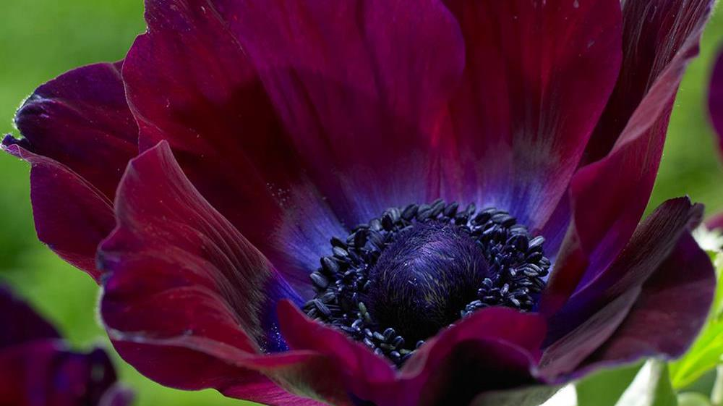
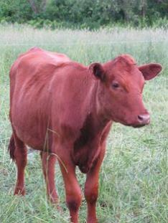
The Red Heifer -
A Link to Salvation?
Colours of the Crucifixion

Slide 3
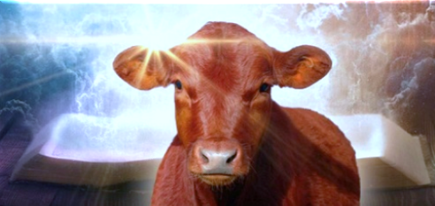
Why - A Worm? 4 – 17
Clean and Unclean? 18 – 21
Storage of the Ashes & Yahusha’s Body! 22 - 29
Waters of Cleansing – Type and Antitype 30 – 38
Refiners Fire (???) 39 – 49
Red Heifer age requirement 50 – 52
Shani - The Double, in Scarlet 53 – 69
The “Blood” of the Golden Calf! 70 - 87
Contents: Part 3

Slide 4
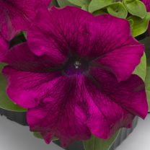
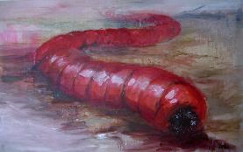
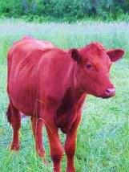
Why add scarlet
to the red heifer fire?
Why
“a WORM?”
Crimson

Slide 5


Yahusha - “the worm?” < towla`H8438>
WORM - H8438 towla`; [etc.]
from H3216; a maggot
(as voracious); specifically (often with ellipsis of H8144) the crimson-grub, but used only (in this connection) of
the color from it, and cloths dyed therewith: KJV - crimson, scarlet, worm.
Is there a deeper meaning that is worth looking into?
Ps 22:1 has the well known words of:
My El, my El, why hast thou forsaken me? why art thou so far from helping me, and from the words of my roaring?
Psa 22:6 utters the words <towla`/worm>
speaking of Yahusha as a worm.
“I am a worm, [H8438] and [a] no man; a reproach
of men, and despised of the people.” KJV
This expression is speaking of Yahusha as
“a prepared worm” or a “crimson worm” –
like the deep red color of blood.

Slide 6
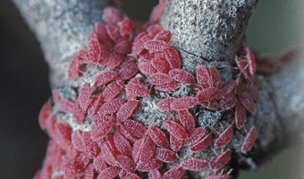
Psa 22:6 But I am a worm, and no man; A reproach of men, and despised by the people.
Yahusha identifies Himself with a lowly
‘grub like’ creature of His own making!

Slide 7
Information on this SCARLET dye -
Scarlet (54 Occurrences)
... This dye was obtained by the Egyptians from the shell-fish Carthamus tinctorius;
and by the Hebrews from the Coccus ilicis, an insect which infests oak trees ...
Worm (22 Occurrences) ... (tola`ath shani (Exodus 25:4, etc.)): Cermes vermilio, a scale insect from which
a red dye is obtained. ... The dye is made from the dried bodies of the females.
/w/worm.htm - 21k BIBLE HUB
“I am a Worm?”
Double dipped
Scarlet.htm -
Identified as Yahusha?

Slide 8
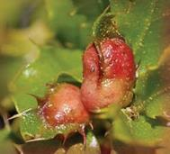
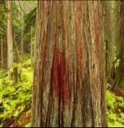
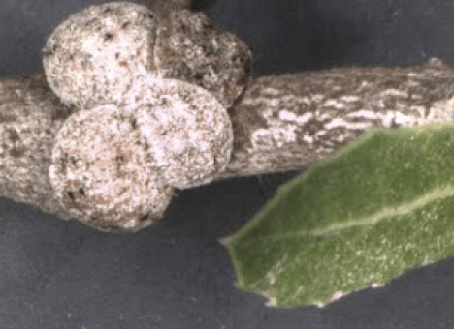
The Sacrifice by the “Crimson Worm”
The mother Crimson worm
gives birth to her young
only ONCE in her life.
She attaches her body to a TREE, fencepost or a stick – then she makes a hard CRIMSON shell.
This shell can not be removed without KILLING her.
The eggs are laid UNDER HER BODY and protective shell – giving PROTECTION to the young.
The young feed on the
LIVING BODY of the mother.
When the young can survive on their own the mother DIES.
As Crimson mother worm dies, she oozes a crimson or scarlet red dye which not only STAINS THE WOOD SHE IS ATTACHED TO, but also her young are stained.
The young are colored SCARLET
for THE REST OF THEIR LIVES.
After THREE DAYS the dead mother loses its crimson color and TURNS into a WHITE wax which falls to the ground LIKE SNOW.

Slide 9
The “Crimson Worm” Linkage
The mother Crimson worm
gives birth to her young
only ONCE in her life.
Yahusha, provides us with
life, ONCE on this earth.
This shell can not be removed without KILLING her.
Rejecting the MelchiTzedek Order
Pact which contains our Eternal
Plan of Salvation, nullifies each
and every possibility for Life itself.
She attaches her body to a TREE, fencepost or a stick – then she makes a hard CRIMSON shell.
Yahusha volunteered to be crucified
on a wooden structure: at the same
time, permanently sealing and
solidifying the Blood Ratified
Covenant Plan for our Salvation –
for ETERNITY!
4. The eggs are laid UNDER HER
BODY and protective shell – giving
PROTECTION to the young.
Yahusha (The Door) formed
Salvation (direct access to Yahuah)
through His Sacrifice, and, by
becoming the First- Fruit through
victory over death. This factor
provides us with Eternal Life.

Slide 10
“Crimson Worm” Linkage
The young feed on the LIVING BODY of the mother.
Yahusha’s people need to develop
a permanent connection with the
Ruach Ha Qodesh, and an
insatiable desire to live under the
MelchiTzedek Administration
guidelines.
When the young can survive on their own the mother DIES.
Yahusha fulfilled every detail of the Will of His Father and
declared – It is finished –
with extreme flawless perfection.
He provided us with an immaculate guideline for LIFE, He then sacrificed HIS OWN LIFE
at Golgotha.
As Crimson mother worm dies, she oozes a crimson or scarlet red dye which not only STAINS THE WOOD SHE IS ATTACHED TO, but also her young are stained.
When Yahusha shed His Blood for
us and we accept His Sacrifice, we
assume the “colour” of His blood,
marking our life for eternity.

Slide 11


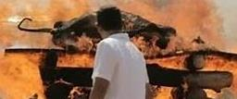
The “Crimson Worm” Linkage
The young are colored SCARLET
for THE REST OF THEIR LIVES.
Yahusha fulfilled the condition of death (blood shed) per consequence of breaking The Covenant; which was illustrated by the split sacrifices in the covenant given to Abraham.
We, having accepted His Sacrifice
as children of Yahusha, being
received into Yahuah’s eternal Kingdom, retain and glow the characteristics of Yahusha - eternally.
But I am a worm … Ps 22:6
Scarlet into the fire … Num 19:6
Burn it with its BLOOD …
Type AND ANTITYPE is –
For the cleansing of people.
It is Finished John 19:30

Slide 12
Final “Crimson Worm” Linkage
After THREE DAYS the dead mother loses its crimson color and TURNS into a WHITE wax which falls to the ground LIKE SNOW.
Yahusha was placed inside the clean tomb in the minutes before Dawn of the 5th cycle of the week (Thu.)
(Luke 23:54).
3 Light Seasons, and 3 Night Seasons later, in the minutes before Dawn, He met Mary Magdalene near the tomb
(John 20:14).
Yahusha, the FLAWLESS {WHITE} Kohen Ha Gadol, of the
MelchiTzedek Order, prepared to present Himself
on the Mo-ed of the Wave Sheaf -
as the PERFECT First-Fruit,
fresh from victory over death,
in the court of His Father Yahuah -
WHITER THAN SNOW!
A Towla Hallelu-Yah

Slide 13
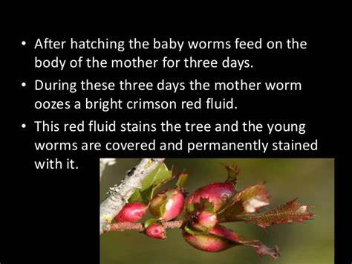
Review

Slide 14

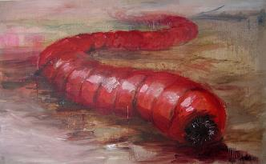
Yahusha and the “Crimson Worm”
How does Yahuah’s mercy
connect to the “worm”?
Yahusha gave up His life on a TREE ….
This sacrifice was given so His
children might be WASHED with
His crimson blood.
Result? Their sins are cleaned up
white as snow.
Upon Yahusha’s resurrection, His children feed on His Body, and are covered with His CRIMSON blood.
The “wood” and the “young” are colored
SCARLET for THE REST OF THEIR LIVES.
6. Yahusha’s children are promised
a WHITE ROBE and eternal life because
of this CRIMSON blood.
7. Isa 1:18 Come now, and let us reason
together, saith Yahuah:

Slide 15
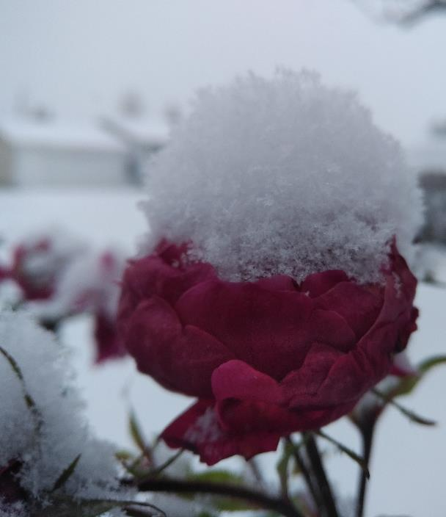
… though your sins
be as scarlet, they shall be as
WHITE AS SNOW;

Slide 16
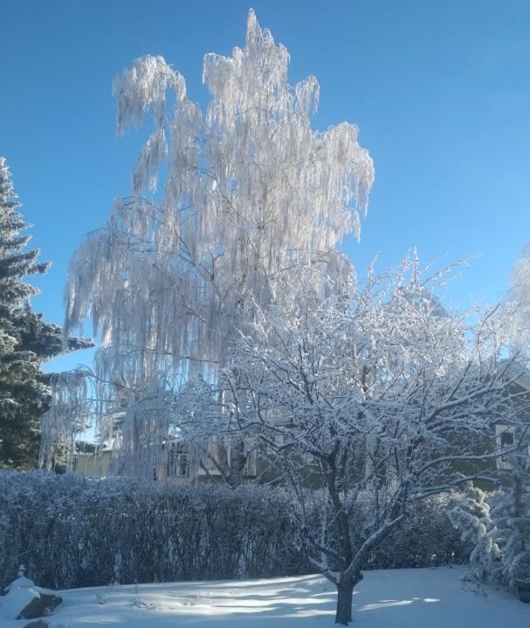
though they [your sins]
be red like crimson,
they shall be
as wool.

Slide 17

Yes! That – Worm! !!!
The picture being presented, is it beginning to resemble that of
Yahusha Ha Mashiach?
In Job 25:6, - was Job correctly identifying Yahusha as The Worm?

Slide 18
The cedar wood of the red
heifer sacrifice fire, symbolizes
this earth upon which we live.
This earth is the future home of Yahuah and Yahusha.
He is permanently attached to it
to the point of planning to
rebuild it and live here, one day!
This cedar wood will be purified by fire at the final time.

Slide 19
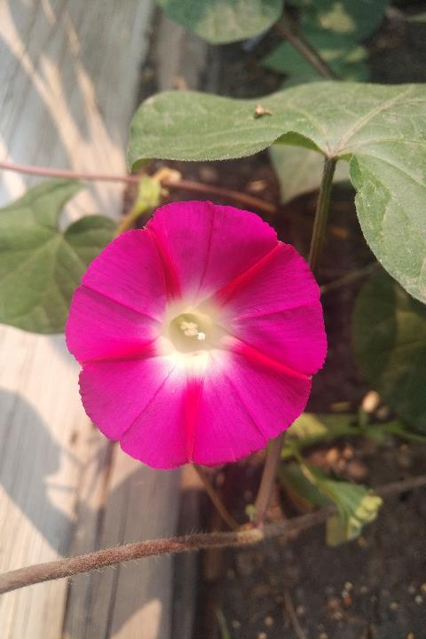
Who becomes Unclean?
Who becomes CLEAN?

Slide 20
Considering - The Uncleanliness
Num 19:7 The priest shall then wash his garments, and shall bathe his body in water, and afterward come into the camp, but the priest is unclean until evening.
Note: The Chief of Priests (and the one doing the burning – v:8) becomes unclean.
What about Yahusha? Did He, while presiding as the MelchiTzedeq Kohen Ha Gadol over the Paschal Sacrifice, also become unclean?
2 Cor 5:21 For He made Him who knew no sin TO BE SIN for us, so that in Him we might become the righteousness of Elohim.
High Priest

Slide 21
And the One doing the burning?
Can we see a connection from the one doing the burning of the
Red Heifer, to Yahusha suffering the crucifixion? Yahusha, the Kohen Ha Gadol, authorized the sacrifice by voluntarily allowing Himself to suffer. By volunteering to suffer, He also became the One performing the “burning” of the sacrifice.
Yahusha, fulfilling the Antitype position, “became unclean with
our sins” – NOT HIS OWN!
Num 19:8 And he that burneth her shall wash his clothes in water, and bathe his flesh in water, and shall be unclean until the even.
Yahusha, inherently housing the Clean Water of Life, like the death of the Towla worm, appeared 3 days and 3 nights later – White - (Clean) as snow. He was fully prepared to BE the Firstfruit
in the Heavenly Court of Yahuah.

Slide 22
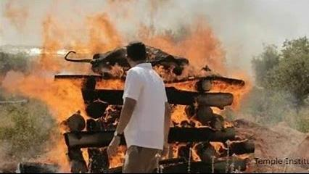
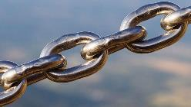
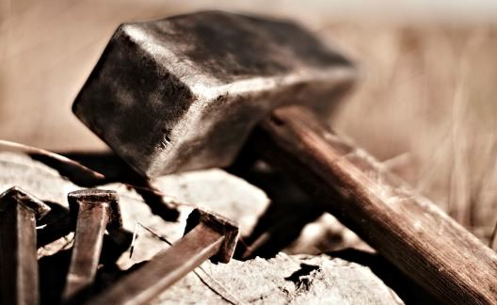
Type and Antitype Uncleanliness?
Yes, Yahusha Ha Mashiach the MelchiTzedeq Kohen Ha Gadol
was Perfect and Flawless;
yet He was cloaked with
OUR uncleanliness
at the Paschal Sacrifice.
Yes, the one doing the burning, and the High Priest,
became unclean at the
red heifer sacrifice.

Slide 23
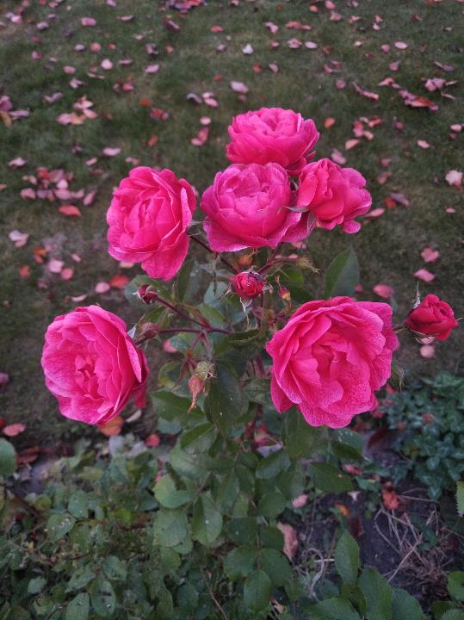
The storage commanded for the Red Heifer ashes!
&
Where was the body of Yahusha stored?

Slide 24
Num 19:9 (a) ‘And a clean man shall gather up the ashes of the heifer, and shall place them outside the camp in a clean place.
John 19:38 And after this, Yosĕph of Ramathayim, being a taught one of יהושע [Yahusha], but secretly, for fear of the Yehuḏim, asked Pilate that he might take the body of יהושע [Yahusha], and Pilate gave permission. Therefore he came and took the body of יהושע.
John 19:39 And Naḵdimon [Nicodemus], who at first came to יהושע [Yahusha] by night, also came, bringing a mixture of myrrh and aloes, about a hundred pounds.
Could Yoseph and Nakdimon fulfill the “clean man” requirement for the remains of the Red Heifer Antitype clean up requirement?
Watch for the next appearance!

Slide 25
Yoseph was for all intents and purposes, a “clean” man doing his best to be a follower of Yahusha. After the sun had set, he requested the precious body and orchestrated the burial process.
(Matt 27:57,58/ Mark 15:42,43 & ref to Mark 1:32 for starters.)
Nakdimon also had shown a dedication to Yahusha which cleared the path for him to be a clean man to help with the burial of Yahusha.
Why was the “clean man” requirement so important?
The ashes of the red heifer could not be contaminated by sinful representation. It was imperative -the ashes MUST be kept clean
to be capable of fulfilling the commission of cleansing mankind.

Slide 26
The Qodesh Parallel - to the Ashes!
The body of Yahusha necessarily must have been embalmed by
upright “clean” men.
His body MUST NOT be contaminated by the impurity of mankind. Yoseph and Nakdimon were the cleanest men available at that time.
Yahusha’s body necessarily MUST have been kept clean of impurity,
for when He arose, He was to present Himself on the
Feast of the Wave Sheaf (Lev 23:11,15) to fulfill the First-Fruit
(1 Cor 15:20,23) presentation as
THE FLAWLESS FIRST-FRUIT VICTORY OVER DEATH!
If the body of Yahusha had been contaminated by UNCLEAN men,
we would not have a Mashiach!
His OFFERING would not have been acceptable to Yahuah!

Slide 27

Mar 14:26 And having sung a song, they went out to the
Mount of Olives.
Mar 14:32 And they came to a place called Gethsemane.
And He said to His taught ones, “Sit here while I pray.”
Joh 19:41 And at the place where He was impaled there was a garden, and in the garden a fresh tomb in which no one had yet been laid.
Are we recalling the Divine instruction that the ashes of the Red Heifer must be placed in a CLEAN PLACE? Num 19:9!
Are these parallels just coincidence? Or are these part of the
Plan of SALVATION intended from the foundations of this earth?
The Clean Place! ☺

Slide 28
We will do well to thoroughly consider John’s next statement.
Joh 19:42 There, then, because of the Preparation Day of the Yehuḏim, they laid יהושע [Yahusha], because the tomb was near.
Again, we see that indeed Yahusha suits the Antitype of the red heifer as, just like the heifer, Yahusha’s body also was stored -
“outside the camp” - of Jerusalem.
Hang on! John declares this Night Season of PREPARATION FOR BURIAL as STILL – the PREPARATION! Once again the sunset FAILED to change the cycle! It was certainly not Sabbath evening/night, but was indeed the Preparation Night Season just prior to the 1st Sabbath of Unleavened Bread, (at Dawn), on the 5th cycle of the week! ☺

Slide 29
Again, - we will thoroughly consider John’s statement.
John 19:42 (a)
There, then, because of the Preparation Day of the Yehuḏim,
John is confirming that indeed the PREPARATION (of the lunar based Jewish Pesach), had commenced with the sunset!
They too were “preparing” for the 1st Sabbath of Unleavened Bread, yet they – starting from that sunset – still had 24 hours more to go!
Yet according to The Covenant statute, the Antitype Body of Yahusha, was to be processed, and placed out of sight, Exo 12:10, before the
1st Sabbath of U/B started at - DAWN!

Slide 30
Is it any wonder why Yahuah Inspired –
Isa 1:14 - 16 Your new moons and your appointed seasons My soul HATETH; they are a burden unto Me; I am weary to bear them.
And when ye spread forth your hands, I will hide Mine eyes from you; yea, when ye make many prayers, I will not hear; your hands are full of blood.
Wash you, make you clean, put away the EVIL of your doings from before Mine eyes, cease to do evil;
Lunar based appointed times – is a PAGAN SYSTEM OF WORSHIP, and is in direct opposition to Yahuah.
See also Isa 14:13.

Slide 31

Waters – Type and Antitype

Slide 32
OK! Back to the Red Heifer’s Ashes!
Num 19:9 (b) … And they [red heifer ashes] shall be kept for the congregation of the children of Yisra’ĕl …
The ashes saved from the red heifer burnt offering were gathered with the specific purpose of cleansing Yisra’el (any person who chooses to accept Yahusha) from their sins.
So ALSO - Yahusha came to save people from their sins by Salvation through His voluntary sacrifice.
Again we see immaculate linear alignment between the red heifer offering and that of Yahusha Ha Mashiach. ☺

Slide 33

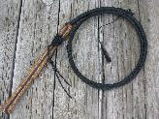
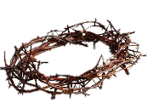

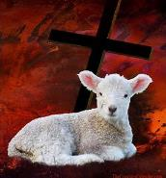

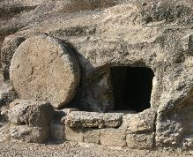
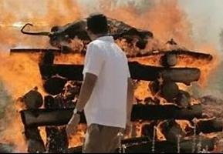
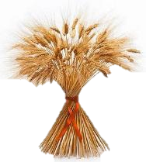
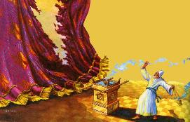
2 SACRIFICE TYPE(S)
THE ANTITYPE SACRIFICE
Yahusha
Replaces by Fulfilling the Type.
Scarlet
Towla’s cleansing colour.
Dom (blood) -
supply of LIFE to “The Body.”

Slide 34
Num 19:9 (c) … the water for uncleanness, it is for cleansing
from sin.
Yahusha ALSO has “water.” Spiritual water for the believer, and in the physical aspect we read of water and blood pouring out from His body when it was impaled on the cross.
John 19:34 But one of the soldiers pierced His side with a spear,
and instantly blood and water came out.
The blood covered - forgiveness of sin, and the water is for the cleansing of mankind – that is, if they choose to accept Yahusha.

Slide 35
Num 19:9 (c) … the water for uncleanness, it is for cleansing
from sin.
Yet Yahusha has a spiritual “water” for the believer.
John 4:14 but whoever drinks of the water I give him shall certainly never thirst. And the water that I give him shall become in him a fountain of water springing up into everlasting life.”
The ashes mixed with water from the red heifer offering could preserve life under the Book of the Law umbrella. However, when the priesthood transfer of the Aharonic Priesthood to Yahusha the Kohen Ha Gadol (High Priest) of the MelchiTzedeq Order took place, this “water” under a “better covenant” (Heb 8:6) preserves life eternally!

Slide 36
Num 19:10 ‘And he who gathers the ashes of the heifer shall wash his garments, and is unclean until evening. And it shall be a law (H2708) forever to the children of Yisra’ĕl and to the stranger who sojourns in their midst.
The Gentile who chooses to accept Yahusha is included in the term – Yisra’el. This sin offering was universal in scope.
Num 19:11 ‘He who touches the dead of any human being is unclean for seven days.
Num 19:12 ‘He is to cleanse himself with the water on the third day, and on the seventh day he is clean. But if he does not cleanse himself on the third day, then on the seventh day he is not clean.

Slide 37
Num 19:13 ‘Anyone who touches the dead of a human being, and does not cleanse himself, defiles the Dwelling Place of יהוה [Yahuah]. And that being shall be cut off from Yisra’ĕl. He is unclean, for the water for uncleanness was not sprinkled on him, his uncleanness is still upon him.
On a spiritual plane -
Any person who partakes in the evil of mankind, and does not repent, defiles the tabernacle (our body) of Yahuah. If there is no repentance, the “cleansing water of life” has been rejected and the final result will be destruction (putrefaction) of that person.

Slide 38

Num 19:14 ‘This is the Torah when a man dies in a tent: All who come into the tent and all who are in the tent are unclean for seven days,
Num 19:15 and every open vessel which has no cover fastened on it, is unclean.
Any person who has not accepted the covering armour of Yahusha can and will be contaminated by man’s perverseness.
Num 19:16 ‘Anyone in the open field who touches someone slain by a sword or who has died, or a bone of a man, OR A GRAVE, is unclean for seven days.

Slide 39
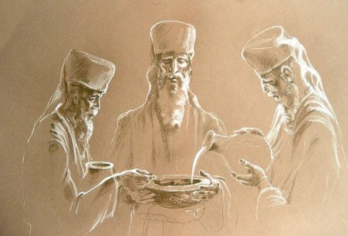
Num 19: 17
And for the unclean being they shall take some of the
ASHES OF THE HEIFER BURNT FOR CLEANSING FROM SIN,
and running water shall be
put on them in a vessel.
Does Yahusha also use a system of BURNING to cleanse His people?

Slide 40
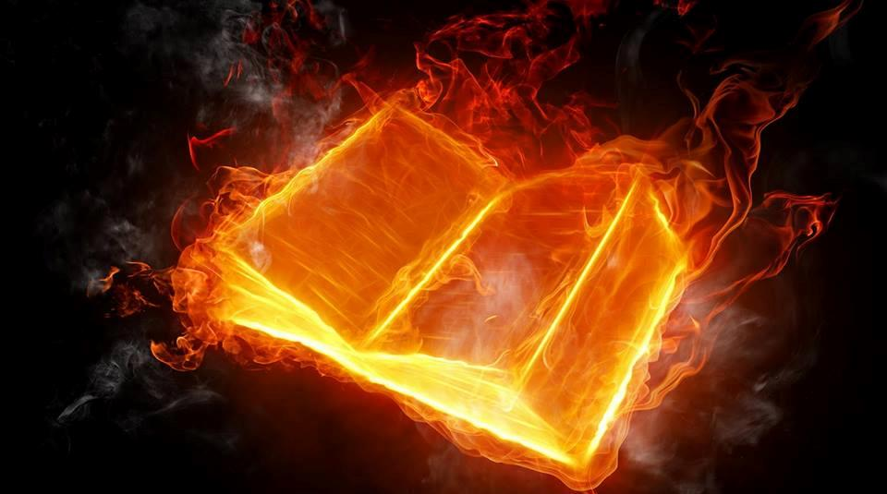
The Refining Fire!

Slide 41
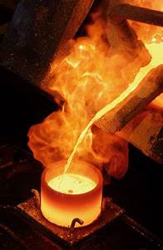
Zec 13:9 And I will bring the third part through the fire, and will refine them as silver is refined, and will try them as gold is tried: they shall call on my name, and I will hear them: I will say, It is my people: and they shall say, Yahuah is my Elohim.
A refiner's fire does not destroy indiscriminately like a forest fire. A refiner's fire does not consume completely like the fire of an incinerator.
A refiner's fire separates and purifies.

Slide 42
Can it be said that from Yahusha “being placed in a grave,” He then received the putrefaction of death, causing Him to be “unclean” for 7 days after He arose from the grave?
Would this “corruption by death” have caused Yahusha to offset
His Wave Sheaf/First-fruit presentation by 7 days as Enoch Calendar claims go?
Or did Yahusha as the Antitype, fulfill the Type pattern set down by the ashes of the Red Heifer (STATUTE), as being placed in a contained area of NO CONTAMINATION?
Luke 23:53 And he took it down, and wrapped it in a linen cloth, and laid him in a tomb that was hewn in stone, where never man had yet lain.

Slide 43
No! Yahusha never received contamination from the tomb. Not according to the Scriptures! Yahusha arose in a PURE and UNDEFILED state, ready to fulfill the statutes of the Wave Sheaf feast. Yahusha was & is the First Fruit offering!
That tomb where Yahusha was placed had never experienced a decaying human in it. It was UNDEFILED!
1 Cor 15:20,22

Slide 44
Yahusha went through His own “CLEANSING FIRE” just volunteering through the Passion Week.
He was “tried and purified” through these trials including all through His life on earth.
Volunteering unto death being sinless, “cleansed” Him and qualified Him, to be worthy for His commission to cleanse mankind from sin. Not just equal to the red heifer ashes, but infinitely and exceedingly more, - FOR ALL ETERNITY!
HALLELU-YAH

Slide 45
Review (from part 2) of the Clean Tomb
Golgotha!
Num 19:9(b) - and shall place them outside the camp in a clean place.
Luk 23:50 -54 And see, a man named Yosĕph, a council member, a good and righteous man, - (v:51) he was not agreeing with their counsel and deed - from Ramathayim, a city of the Yehuḏim, who himself was also waiting for the reign of Elohim, (v:52) he, going to Pilate, asked for the body of יהושע. (v:53) And taking it down, he wrapped it in linen, and laid it in a tomb hewn out of the rock, where no one was yet laid. (v:54) And it was Preparation day, and the Sabbath was approaching.
Clean!
Clean!
Mat 27:59 - 60 And having taken the body, Yosĕph wrapped it in clean linen, (v:60) and laid it in his new tomb which he had hewn out of the rock. And he rolled a large stone against the door
of the tomb, and went away.
Clean (Ashes in a CLEAN PLACE) !

Slide 46
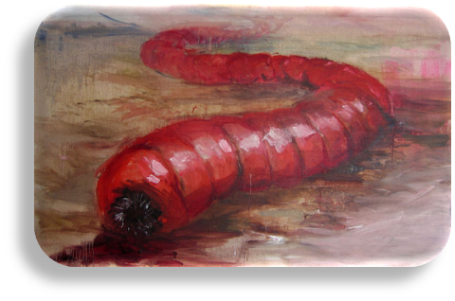
Acts 13:35 “For this reason He also says in another Psalm, (Psalm 49:9)
‘You shall not give Your Kind One to see corruption.’
Acts 13:36 “For Dawiḏ, indeed, having served his own generation by the counsel of Elohim, fell asleep, was buried with his fathers, and saw corruption,
Acts 13:37 but He whom Elohim raised up SAW NO CORRUPTION.
Acts 13:38 “Let it therefore be known to you, brothers, that through this One forgiveness of sins is proclaimed to you,
What other Scriptural example (TYPE)
delivers a cleansing, portrays
an appearance of corruption (DEATH),
but then a magnificent return to a cleansed
(PURIFIED AS WHITENESS) state?
Towla

Slide 47
Psa 16:10 For You do not leave my being in the grave,
Neither let Your Kind One see corruption.
By Hebrew definition, the grave would cause no destruction nor corruption, whatsoever, upon Yahusha.
No, Yahusha was not contaminated by the grave as humans are. Yahusha arose personally as pure as He entered, the grave.
Yes He assumed OUR sin! Not His sin - for He had no sin!
Yahusha DID NOT OFFSET THE WAVE SHEAF OBSERVATION, (an Enoch requirement.) He executed HIS OWN Plan of Salvation immaculately!
Yahusha arose from the grave in a PREFECTLY FLAWLESS STATE. Yahusha arose in FULL READINESS TO EXECUTE THE PRESENTATION OF THE FIRSTFRUIT (by VICTORY OVER DEATH) to fulfill the WAVE SHEAF STATUTE in complete accordance with Leviticus 23:9-15!

Slide 48
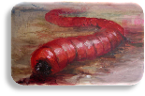
Heb 9:11 But Messiah, having become a High Priest (Kohen Ha Gadol of the MelchiTzedek Order) of the coming good matters, through the greater and more perfect Tent not made with hands, that is, not of this creation,
Heb 9:12 entered into the Most Set-apart Place once for all, not with the blood of goats and calves, but with His own blood, having obtained everlasting redemption.
Heb 9:13 For if the blood of bulls and goats and the ashes of a heifer, sprinkling the defiled, sets apart for the cleansing of the flesh,
Heb 9:14 how much more shall the blood of the Messiah, who through the everlasting Spirit offered Himself UNBLEMISHED to Elohim, cleanse your conscience from dead works to serve the living Elohim?
The “Cleansing Type”

Slide 49
When did Yahusha ascend, offering Himself as the First Fruit offering that by statute was required on the Wave Sheaf Feast day?
John 20:1 And on the first day of the week, Miryam from Maḡdala came early to the tomb, while it was still dark, and saw that the stone had been removed from the tomb.
John 20:17 יהושע said to her, “Do not hold on to Me, for I have not yet ASCENDED to My Father. But go to My brothers and say to them, ‘I AM ASCENDING to My Father
and your Father, and to My Elohim and your Elohim.’ ”
Like the red heifer TYPE smoke that ascended to Yahuah,
so Yahusha fulfilled the Antitype by timely ascending to Yahuah!
Present tense, ASCENDING - “right now!”

Slide 50

On the 1st cycle of the week, the Wave Sheaf, the 1st cutting
(FIRST- FRUIT), was “raised up” (bundled), & presented to Yahuah.
Equally so, Yahusha, on the 1st cycle after the 7th Day Sabbath, the
1st cycle of the week – Abib 18, He ASCENDED (raised up) to present Himself as the First Cutting (First-Fruit, 1 Cor 15:20, 23.) A First-Fruit of victory over death. Yahusha was the Flawless First-fruit!
And in Romans -
Rom 11:16 If the first part of the dough is holy, so is the whole batch.
YAHUSHA
His Children
If the root is holy (set-apart), so are the branches.
The offspring of the “Worm” are permanently stained scarlet through the DEATH of the life giver, (mother) who lays down her life to promulgate her sacrifice to her children.

Slide 51
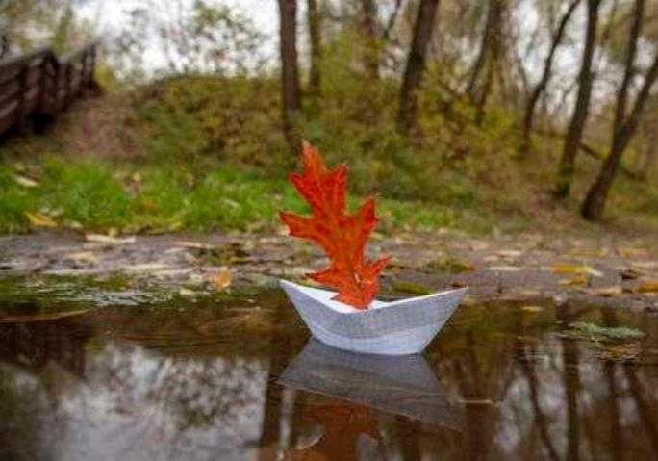
Is the
Red Heifer supposed to be three years old?
“Scarlet On The Water”

Slide 52
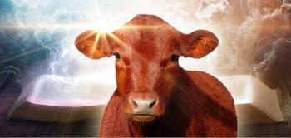
Isa 15:5 & Jer 48:34 speak of a heifer that is 3
years old.
Isa 15:5 My own heart is toward Mo’aḇ; her fugitives cry unto Tsoʽar, like a three-year-old heifer. For by the ascent of Luḥith they go up with weeping; for in the way of Ḥoronayim they raise a cry of destruction.
Jer 48:34 “From the outcry of Ḥeshbon unto Elʽalĕh, unto Yahats, they shall raise their voice, from Tsoʽar to Ḥoronayim, like a three-year- old heifer, for even the waters of Nimrim are dried up.
Note that there is no instruction indicating this to be a RED heifer!
But what about the rule of first mention?

Slide 53
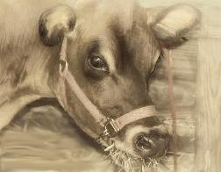
We need to consider the formation of the Covenant as orchestrated by Yahuah, which He placed upon the MelchiTzedek - Abraham.
Gen 15:9 And He said to him,
“Bring Me a three-year-old heifer,
and a three-year-old female goat,
and a three-year-old ram,
and a turtledove, and a young pigeon.”
It is stated quite clearly that the animals that have direct linkage to Yahusha and the Plan of Salvation, were required to be 3 years of age. The age of 3 years set a bar of accountability.
Would the Red Heifer accountability age requirement be any different?

Slide 54
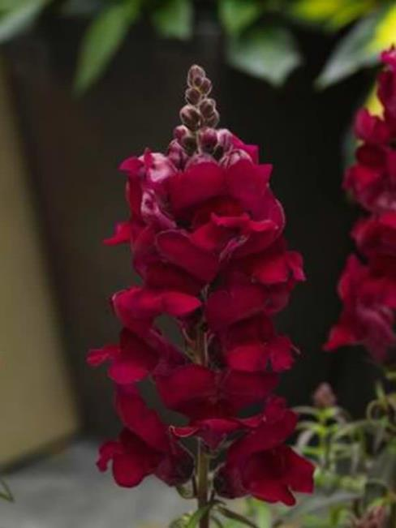
The crimson was of a “double dip” to obtain a deep dark colour of red resembling dried and darkened blood.
Why the double in -
“DOUBLE SCARLET?”

Slide 55
Why a - DOUBLE?
Num 19:6 And the priest^{H3548} shall take^{H3947} cedar^{H730} wood,^{H6086} and hyssop,^{H231} and scarlet,^{H8144 H8438} and cast^{H7993} it into^{H413} the midst^{H8432} of the burning^{H8316} of the heifer.^{H6510}
Why is it that in English translations we see one single word – scarlet – and yet the KJV+ shows through Strong’s numbers, the existence of - TWO HEBREW WORDS?
Are we missing something IMPORTANT?

Slide 56
Strong’s Definitions [?](Strong’s Definitions Legend)
תּוֹלָע tôwlâʻ, to-law'; and (feminine) תּוֹלֵעָה tôwlêʻâh; or תּוֹלַעַת tôwlaʻath; orתֹּלַעַת tôlaʻath; from H3216; a maggot (as voracious); specifically (often with ellipsis of H8144) the crimson-grub, but used only
(in this connection) of the color from it, and cloths dyed therewith:— crimson, scarlet, worm.
In our Scripture translations, Strong’s tells us through the word – ellipsis – that indeed this word H8144 is left out of the translation many times.
The H8144 number is – Shin Nun Vav - Shaniy (= 360) (Strong’s).
Note that it is a masculine noun.
Being masculine facilitates a grammar gender connection to Yahusha!

Slide 57
Note: When H8144 – Shani – is referencing items directly related to Yahusha (Temple articles) the word is seen in its singular form – Shani and is referenced to the towlath) Scarlet Worm.
Some Hebrew scholars declare the H8144 Shani, to be directly related to the family word H8141 Shaneh & H8138 - Shanah – which means –
to double in a perfect mirror like manner.
It is then declared that the scarlet is double dipped.
What then is the reason for the double dipped connotation when connected directly to Yahusha?
Is it referencing the TWO times Yahusha will come to this earth with the last one in a cleansing role?

Slide 58
Is the “double-dipped” referencing –
1. The first time when Yahusha “stained” the saved by shedding His blood at the crucifixion?
2. And the second when He permanently “colours” the chosen with His righteousness for eternity?

Slide 59
Can we also see a parallel in the “double-dipped,” as seen in John?
1. When in John 13:26a Yahusha SPOKE of dipping (G911) the sop into the liquid, thereby marking it, or spiritually, permanently staining the substance for its intended purpose?
2. Then in John 13:26b Yahusha physically dipped (G1686) the sop into the liquid, placing it in the mouth of Judas, pointedly marking the earthly source, for eternity, from whom the evil that was prophesied to befall Him would come.

Slide 60
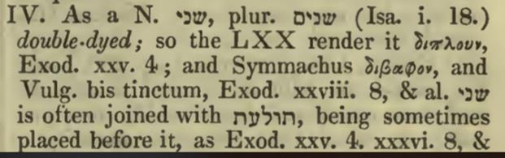
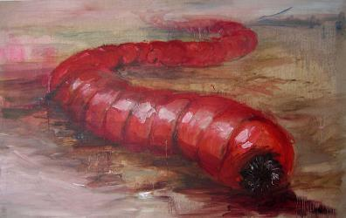
H8144 (Shani) - coccus crimson, deep scarlet
Next Slide!
H8438 towlath
H8138 Shaneh to repeat, do again

Slide 61
Significance of Shani (double) in Isa 1:18.
Isa 1:18 b … though your sin be as scarlet, they shall be as WHITE AS SNOW;
Yahusha says – though your sins are of a “double dip”, a DEEP HABITUAL PERSISTENT EVIL, I will remove them and make them whiter than snow.

Slide 62
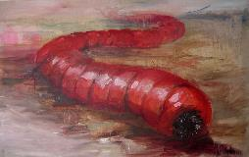
Significance of A SINGLE DIP in Isa 1:18.
DOM - Blood
Isa 1:18 c … though they be red like crimson they shall be as wool.
Yahusha says – even your sins which are not habitually entrenched in your normal life, of them I will cleanse you and make you as wool.

Slide 63
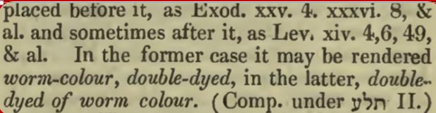
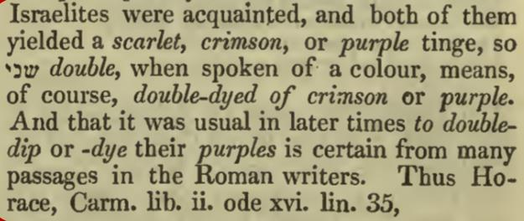

Slide 64
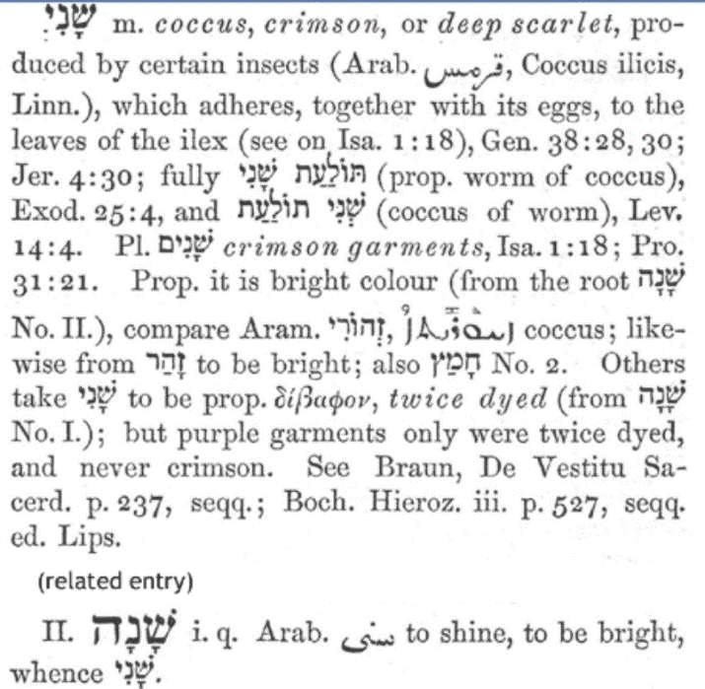
This quote is from the Gesenius Hebrew-Chaldee Lexicon. (BLB)
We begin to see that the first dip rendered a brilliant crimson colour.
The shani (second) dipping produced an
INTENTIONAL PURPLE (Royalty)
colour.

Slide 65
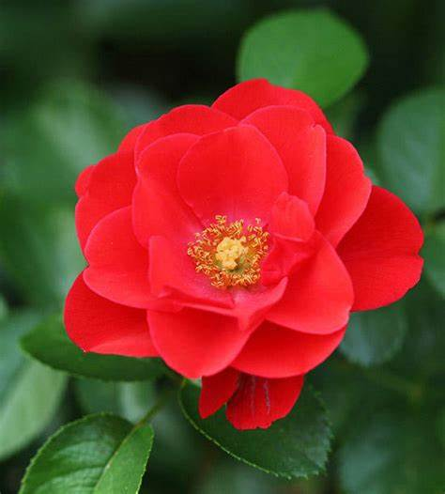
Scarlet
Difference Between
Crimson and Scarlet
As nouns, the difference between scarlet and crimson
is that scarlet is a bright red, slightly orange colour while crimson is a deep, slightly bluish red;
is that scarlet is to dye or tinge with scarlet while crimson is to blush. Mar 28 2019
Reference: wikidiff.com/scarlet/crimson

Slide 66
Crimson
scarlet, crimson
properly, the insect 'coccus ilicis', the dried body of the female yielding colouring matter from which is made the dye used for cloth to colour it scarlet or crimson.

Slide 67
Cochineal (Dactylopius coccus) as one of the most important insects in industrial dyeing
Hamze Esalat Nejad1, Ahmad Esalat Nejad
1 Graduate of Master Textile Engineering, branch Tehran, Islamic Azad University, Tehran, Iran
2 Specializing in the affairs herbal and industrial dyeing crude materials for exquisite carpet weaving, Kashan, Iran
To prepare carmine, the powdered insect bodies are boiled in ammonia or a sodium carbonate solution, the insoluble matter is removed by filtering, and alum is added to the clear salt solution of carminic acid to precipitate the red aluminum salt.
Purity of color is ensured by the absence of iron.
Stannous chloride, citric acid, borax, or gelatin may be added to regulate the formation of the precipitate.
For shades of purple, lime is added to the alum.

Slide 68
Our sins have been and still are, as scarlet and crimson.
A brilliantly glaring, separating flaw, that is first, as a permanent deep dye, and again as solidly entrenched as the double dipped dye. First the original corruption, and then comes the leading into of the multiple threads of
habitual transgression.
Yet by the pardoning mercy of Yahusha, the One who has the ability to REMOVE ALL PERMANENT CRIMSON STAIN, our evil record will become as white as the snow.
Psa 51:7 Purge thou me with hyssop and I shalbe cleane: washe thou me, and I shalbe whyter then snowe.
Bishop’s 1538

Slide 69
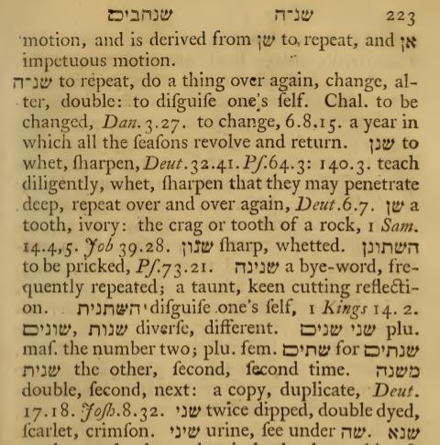
Question: In a lunar year, do the times and dates return again in the exact same time frame as the previous year?
Is it even remotely possible that the lunar years can fulfill
Yahusha’s - SHANEH?
Shani –(double) from the lexicon created by W H Barker 1776.

Slide 70
Shani –(double)
When DOUBLE DIPPED to bring forth Scarlet (a rich deep colour), is the second dipping in an elementally different substance?
Or is it dipped once again in the exact same source of richness?
So it is with the Shaneh (year) of Yahuah. The Shaneh is DOUBLE DIPPED (IF YOU WILL) bringing forth a richness so deeply entrenched in time, that the following year is a complete exact length duplication of the first.
Anything less than an exact duplication is an IMPOSTER SUBSTANCE WHICH REGRESSES TO A DEEP DECEPTION!
My being HATES YOUR NEW MOONS & YOUR APPOINTED TIMES…
Isaiah 1:14

Slide 71
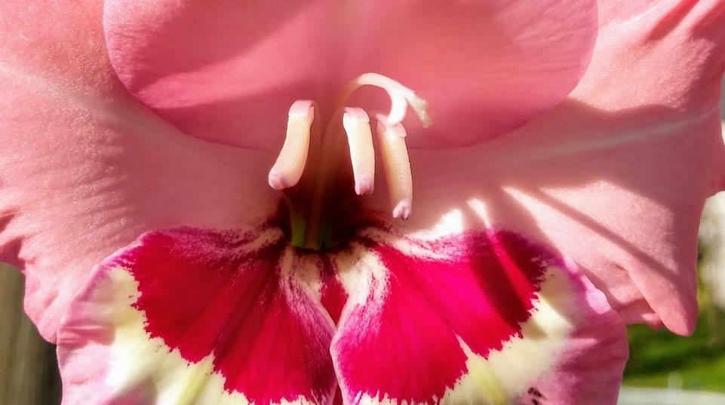
The “Blood” of the Golden Calf!
Next -
How could the
Golden Calf contain Blood?

Slide 72
We have learned quite clearly that it is the BLOOD that has a direct connection to cleansing and purifying. The two primary examples being the blood of the red heifer sacrifice being very essential to the sacrifice, and the most important example being the blood of Yahusha being shed for Atonement for our Salvation.
Do these factors have any connection to Mosheh grinding up the golden calf to fine powder and causing the sinful people to ingest the “BLOOD” mixture?
What was it about the gold/water mixture that was so significant?
We have seen a link from the BLOOD of the red heifer, to Yahusha!
WHAT ABOUT THE “BLOOD” OF THE GOLDEN CALF?

Slide 73
In the Song of Solomon, Yahusha the Bridegroom declares to His Bride,
“Your LIPS are like a SCARLET thread, and your mouth is lovely” (Song of Solomon 4:3).
In this verse, is the Bridegroom (Yahusha), declaring –
His Bride (the chosen ones) are those who speak only of -
Salvation - through the Blood Sacrifice of Yahusha!

Slide 74
Isa 1:18 sins as scarlet
Rev 17:3 a harlot (Mystery Babylon) sitting on a scarlet beast
Rev 17:4 the same harlot clothed in scarlet
The use of the word scarlet to describe the harlot’s clothing symbolizes that she APPEARS to possess something of the life of Yahusha, but she is a harlot and is not interested in making Him her divine Husband. She only wants to look like Him while playing the harlot with all the kings of the earth.
What a difference between the harlot and the sun-clad, star-crowned woman of Revelation 12 who, as the one true corporate Bride of Yahusha, is the one whose lips are like a scarlet thread. She wants to be truly married to Yahusha Ha Mashiach, joined in an eternal union with Him, looking just like Him.
Yahusha’s Bride is fully and completely -
DIAMETRICALLY OPPOSED TO THE SUPERFICIAL WAY OF THE HARLOT.

Slide 75
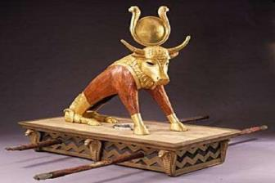
We read that Isa 1:18 declares the sins are as scarlet.
WHAT was the COLOUR of SIN
when the
GOLDEN CALF INCIDENT SHATTERED THE COVENANT?

Slide 76
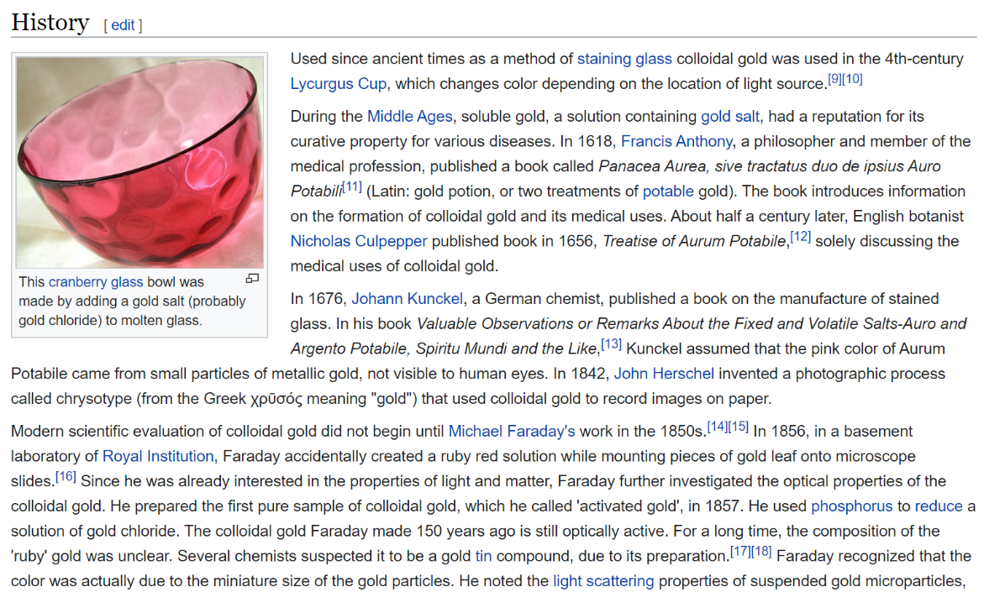

Slide 77
Colloidal gold is a sol or colloidal suspension of nanoparticles of gold in a fluid, usually water.
The colloid is usually either an intense red colour (for spherical particles less than 100 nm) or blue/purple (for larger spherical particles or nanorods). Due to their optical, electronic, and molecular-recognition properties, gold nanoparticles are the subject of substantial research, with many potential or promised applications in a wide variety of areas, including electron microscopy, electronics, nanotechnology, materials science, and biomedicine.
Colloidal gold - Wikipedia
https://en.wikipedia.org/wiki/Colloidal_gold

Slide 78
Ionic gold is what some producers call their non-colloidal gold supplements.
Ionic gold is a gold salt that is dissolved in water. Products labeled as ionic gold are really gold chloride, also called Chlorauric acid, a water soluble gold salt. The reason you don't see gold chloride on the label or mentioned in the ads is because gold chloride is known to be potentially toxic to humans. Gold chloride has been known to cause Peripheral Neuropathy. For more details read the Truth About Ionic Gold.
Ionic gold is actually neurotoxic meaning it is toxic to nerve cells.
Ionic gold is easy to visually identify because it is clear liquid and looks like water.
If it isn't RUBY RED it is not the highest quality colloidal gold.
Mosheh would not force them to ingest a neurotoxin!
Most likely the gold dust and water mixture
turned a RUBY RED colour!
But what was the purpose of their gold consumption??

Slide 79
Colloidal Gold was first prepared in a pure state in 1857 by the distinguished English chemist,
Michael Faraday. Many uses were found for the amazing solutions of "activated gold."
In the nineteenth century, Colloidal Gold was commonly used in the United States to cure alcoholism (then called dipsomania, defined as the uncontrollable craving for alcoholic liquors), and today it is used to reduce dependency on alcohol, caffeine, nicotine, and carbohydrates.
In the United States, as far back as 1885, gold had been known for its healing capabilities for the heart and improved blood circulation. And gold has been used to treat arthritis continuously since 1927.
Europeans have long been aware of the benefits of gold in the system and have been buying
gold-coated pills and 'Gold Water' over the counter for well over 100 years.
In July of 1935, Clinical, Medicine & Surgery had an article entitled "Colloidal Gold in Inoperable Cancer" written by Edward H. Ochsner, M.D., B.S., F.A.C.S. which stated, "When the condition is hopeless, Colloidal Gold helps prolong life and makes life much more bearable, both to the patient and to those about them, because it shortens the period of terminal cachexia (general physical wasting and malnutrition usually associated with chronic disease) and greatly reduces pain and discomfort and the need of opiates (narcotics) in a majority of instances.“
Gold has been known down through the ages to have a direct effect on the activities of the heart,
and helps to improve blood circulation. It is beneficial for rejuvenating sluggish organs,
especially the brain and digestive system, and has been used in cases of glandular
and nervous congestion and lack of coordination.
The body's temperature stabilizing mechanism is restored to balance with gold,
particularly in cases of chills, hot flashes, and night sweats.

Slide 80
Today, medical uses of gold have expanded greatly. It is used in surgery to patch damaged blood vessels, nerves, bones, and membranes. It is also used in the treatment of several forms of cancer. Injection of microscopic gold pellets helps retard prostate cancer in men.
Women with ovarian cancer are treated with colloidal gold, and gold vapor lasers help
seek out and destroy cancerous cells without harming their healthy neighbors.
Every day, surgeons use gold instruments to clear coronary arteries, and gold-coated lasers
give new life to patients with once inoperable heart conditions and tumors.
Colloidal Gold has a balancing and harmonizing effect on all levels of body, mind, and spirit.
It is used to improve mental attitude and emotional states.
It has been reported to promote a feeling of increased energy, will power, mental focus and libido.
According to many studies, colloidal gold increases mental acuity and the ability to concentrate. Colloidal gold is thought to strengthen mental function by increasing the conductivity
between nerve endings in the body and on the surface of the brain.
Gold is an all-natural mineral that is non-toxic and exhibits no interactions with other drugs,
and is easily tolerated by the body.
The fabulous healing properties of gold are slowly but surely being rediscovered,
as modern scientists and physicians uncover what the ancients seem to have known all along:
That gold is indeed a very precious metal.

Slide 81

Has it registered that gold contains very serious healing capabilities?
Not only physically but indeed psychological restoration also?
Did Mosheh have a threefold purpose for commanding
the people to ingest the gold dust?
Physical body restoration;
Psychological MIND restoration bringing clarity and realization
of the seriousness of their infraction to Yahuah’s Covenant.
Permanently reducing the gold contaminated by sin, to a literal waste factor, eliminating any future usage of the same gold!
How many years have we just thought –
WHAT WAS MOSHEH THINKING!?

Slide 82

Did Mosheh, in commanding the ingestion of the gold & water mixture, produce a FORESHADOW TYPE of the
SCARLET WHICH WAS TO BE REQUIREMENT IN THE
RED HEIFER SACRIFICE?
The fine gold mixed with water, produced
healing qualities from their sin.
This exactness is seen within the SCARLET
introduced into the red heifer inferno.
The ashes then later mixed with water
ALSO produced a cleansing result, from sin!
TOWLA

Slide 83

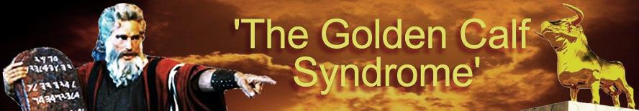
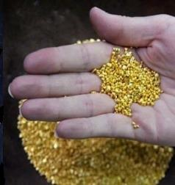
Mosheh had to cleanse the people from their party; which equates with the final day of the false second 50 day count
of the Omer!

Slide 84
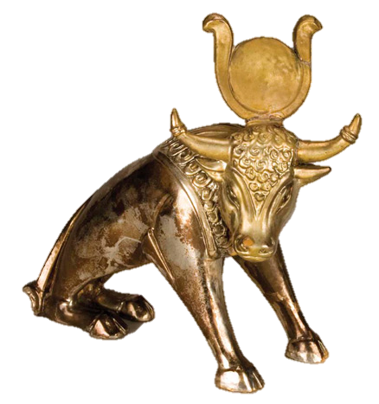
Do you now understand
why Moses had to
grind that golden calf
to gold dust?

Slide 85
We know it was not the physical elements of the colloidal gold mixture which ultimately cleansed from sin.
Could it be the visually intense red colour which symbolized the blood shed by Yahusha, that was acceptable?
And what of the 3000 people who were slain by the men of Levi?
Had their insurrection gone too far in offending Yahuah?
Shall we realize from this epic incident that there is a point of
no return with a final result from sin ending in DEATH?
Is this a warning for us today showing that to refuse
the guidance of the Torah, will result in eternal demise?

Slide 86
And what is – the guidance of the Torah?
Can we insert/overlay our traditional teachings
that are not supported by the Hebrew words –
without consequence?
Shall we accept that which has been Inspired and preserved?
Or are we entitled to overlay our human wisdom and beliefs
onto the Words of the Scriptures?

Slide 87


Looking Back on the Red Heifer information
The Scarlet thread {Shani Towla}, thrown into the Red Heifer sacrifice
at the hottest point, LEADS US FORWARD TO the
Ultimate Sacrifice of Yahusha Ha Mashiach.
The blood was commanded to remain inside the animal for the sacrifice. It was the blood within the ash and water mixture, which contained
the cleansing qualities needed to save mankind.
It is Yahusha’s Blood ALONE, which cleanses and atones for us.
There is NO SUBSTITUTE!

Slide 88
The Red Heifer BLOOD TYPE, was fulfilled by
Yahusha (the Antitype)
at Golgotha, when He voluntarily shed His own Divine Blood.

Slide 89




Choose ye this day whom ye will serve!
Questions & Comments are welcome!
Tim Astleford
tim@studythecalendar.com
questions@studythecalendar.com
Thank you!
www.studythecalendar.com

